Slide 1

moose for dcs world DESIGNATION

Slide 2
DESIGNATE fsm
Designating
Detect
LaseOn
*
Lasing
*
LaseOff
Smoke
*
Illuminate
*
Done
Status

Slide 3
designation

Slide 4
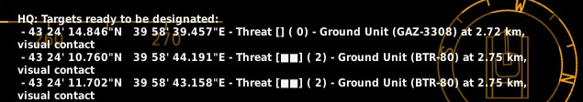
DESIGNATe: DETECTION
RecceSet 2
Functionalities
RecceSet 1
B
A
C
D
Multiple RecceSets (SET_GROUP) detect multiple TargetSets (SET_UNIT) by DETECTION_ classes.
Works with DETECTION_ classes, thus different detection grouping methods are supported:
PER UNIT => DETECTION_UNITS
TargetSet 1
TargetSet 2
TargetSet 3
TargetSet 5
TargetSet 4

Slide 5
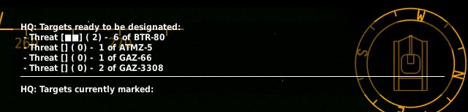
DESIGNATe: DETECTION
RecceSet 2
Functionalities
RecceSet 1
B
A
C
D
Multiple RecceSets (SET_GROUP) detect multiple TargetSets (SET_UNIT) by DETECTION_ classes.
Works with DETECTION_ classes, thus different detection grouping methods are supported:
PER TYPE => DETECTION_TYPES
TargetSet 1
TargetSet 2
TargetSet 3
TargetSet 4

Slide 6
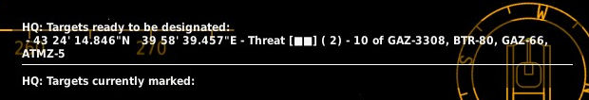
DESIGNATe: DETECTION
RecceSet 2
Functionalities
RecceSet 1
B
A
C
D
Multiple RecceSets (SET_GROUP) detect multiple TargetSets (SET_UNIT) by DETECTION_ classes.
Works with DETECTION_ classes, thus different detection grouping methods are supported:
PER AREA => DETECTION_AREAS
TargetSet 1
TargetSet 2

Slide 7
mark targets by laser

Slide 8
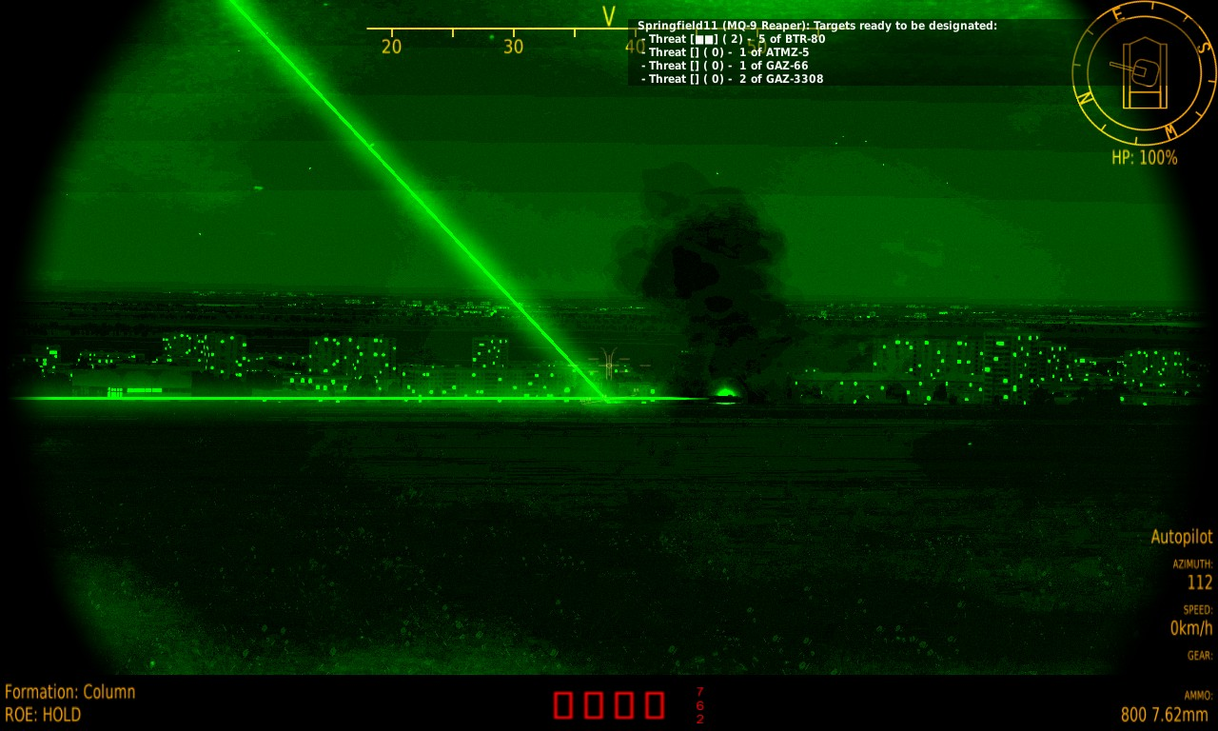
DESIGNATe: lasing
RecceSet 2
Functionalities
RecceSet 1
B
A
C
D
Lasing will try to let each Recce lase a Target. Try, because sometimes there aren’t enough laser codes available, or there aren’t enough Targets to be lased!
TargetSet 1
TargetSet 2

Slide 9
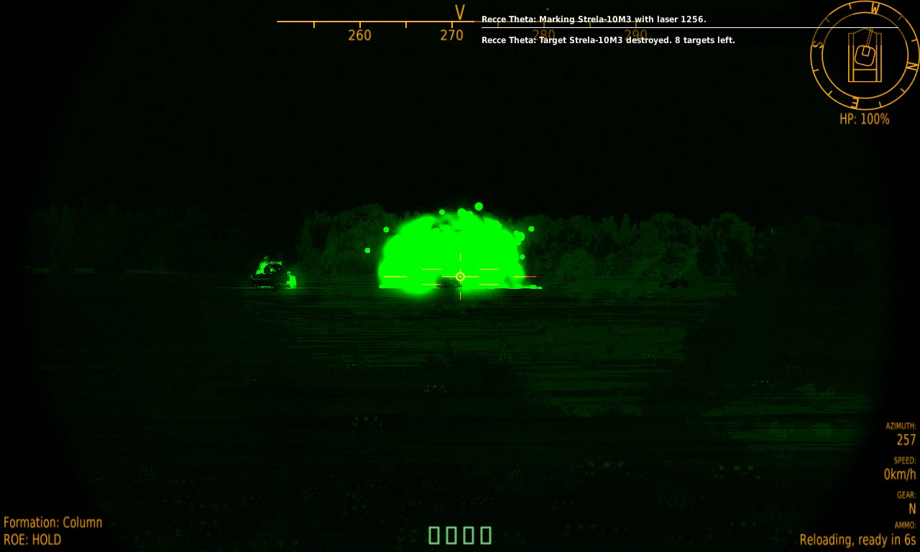
DESIGNATe: target destroyed
RecceSet 2
Functionalities
RecceSet 1
B
A
C
D
After a Target has been destroyed, a Recce will change Target automatically.
TargetSet 1
TargetSet 2

Slide 10
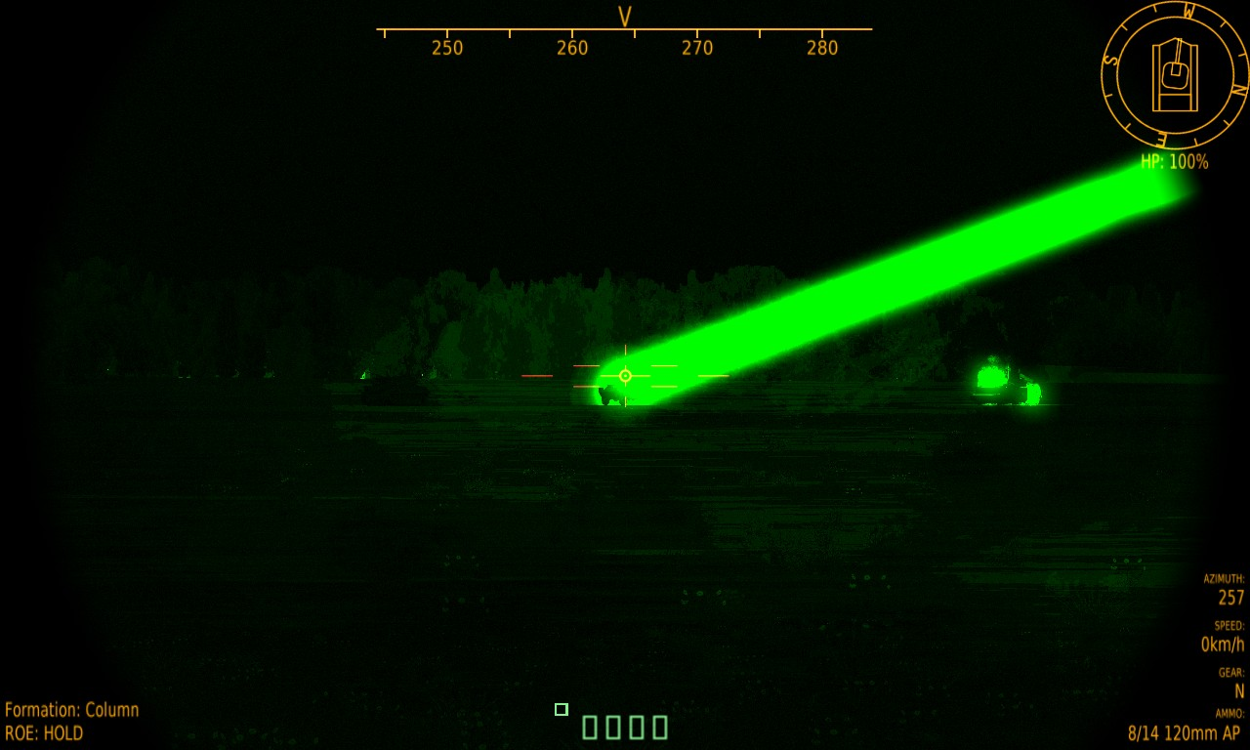
DESIGNATe: lase one targetset
RecceSet 2
Functionalities
RecceSet 1
B
A
C
D
Only one TargetSet can be lased specifically.
TargetSet 1
TargetSet 2

Slide 11
DESIGNATe: all targets destroyed
RecceSet 2
Functionalities
RecceSet 1
B
A
C
D
Once all Targets are destroyed of a TargetSet, the TargetSet will be removed from the Designation scope.
TargetSet 2

Slide 12
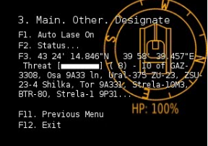
DESIGNATe: lasing remaining targets
RecceSet 2
Functionalities
RecceSet 1
B
A
C
D
Any remaining TargetSet can be activated to be Lased through the menu.
TargetSet 2

Slide 13
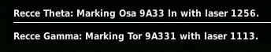
DESIGNATe: laser codes
RecceSet 2
Functionalities
RecceSet 1
B
A
C
D
Lasing can only be done with specific laser codes, which can be limited to one laser code available. In that case, only the amount of Recces will be selected as there are laser codes available. For example, the Su-25T can only lase with laser code 1113. So if only laser code 1113 can be used, then only ONE Recce will lase at the same time, athough there are 4 available! :SetLaserCodes() allows to set specific laser codes.
1113
TargetSet 2

Slide 14
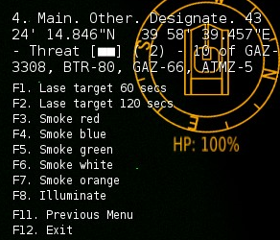
DESIGNATe: lasing duration
RecceSet 2
Functionalities
RecceSet 1
B
A
C
D
Lasing can be active for a specific duration. For example a Recce would only beam for about 120 seconds. After 120 it will stop beaming. In this case, an other Recce will beam to another available target.
1113
TargetSet 2

Slide 15
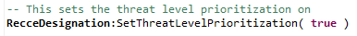
DESIGNATe: lasing
RecceSet 2
Functionalities
RecceSet 1
B
A
C
D
Prioritization based on Threat Level of the Targets can be achieved.
Use the method :SetThreatLevelPrioritization() to activate.
TargetSet 1
TargetSet 2

Slide 16
mark targets by smoke

Slide 17
DESIGNATe: smoking targets
RecceSet 2
Functionalities
RecceSet 1
B
A
C
D
Targets can be smoked in
Red
Blue
Green
White
Orange
Depending on the amount of targets, not all targets may be smoked… It is the “area” around the target that will be smoked…
TargetSet 1
TargetSet 2

Slide 18
mark targets through illumination

Slide 19
DESIGNATe: illuminating targets
RecceSet 2
Functionalities
RecceSet 1
B
A
C
D
Targets can be illuminated through an illumination bomb.
Depending on the amount of targets, not all targets will be illuminated… It is the “area” around the target that will lightened up…
TargetSet 1
TargetSet 2

Slide 20
status

Slide 21
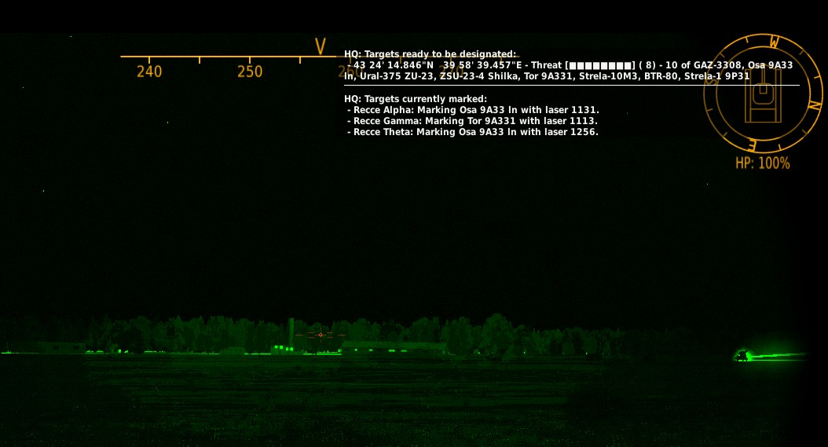
status report
Functionalities
The Head Quarters (the name of the Command Center is HQ) is reporting.
First, it shows the targets ready to be designated. In this example, grouping is done per AREA.
Second, the Targets that are currently marked are listed.

Slide 22
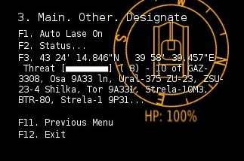
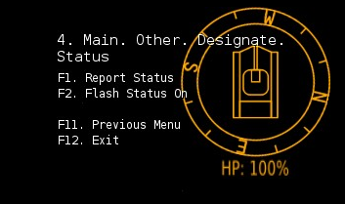
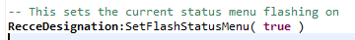
STATUS REPORT activation
Functionalities
The status report can be shown by selecting F1.
The status report can be flashed once a new detection has been done.
Note that by default the flashing of the status report is off, and can be activated through the Designation Menu (F2) or Programmatically.

